Slide 1
STROKE PATIENT HEALTHCARE USING DEEP LEARNING
An overview of data preprocessing,visualization and data encoding.
By Athira Viju

Slide 2

Objective of the project:
The central aim of this project is to conduct a comprehensive analysis of healthcare data to uncover significant patterns and develop a high-accuracy predictive model to assess the likelihood of health conditions, such as stroke. By leveraging robust data exploration, insightful visualizations, and machine learning techniques, this project aims to derive actionable insights and reliable predictions.

Slide 3
Our aim
The goal
To analyze the dataset and build a machine learning model that predicts stroke occurrence based on patient health data.
To derive meaningful insights from the data through preprocessing and visualization, and to evaluate the performance of various models to identify the most effective one for accurate predictions.

Slide 4
Project Overview
01
02
03
04
The project focuses on analyzing healthcare data to uncover patterns and build a high-accuracy predictive model for assessing stroke risk. It encompasses four milestones that systematically progress from data exploration to model development.
Data Preparation
Data Visualization
Data Encoding
Machine Learning Models

Slide 5

01
Data
Preparation

Slide 6
Dataset Characteristics
The dataset consists of 5110 entries across 12 attributes, incorporating both numerical and categorical features.
Key columns include age, gender, hypertension, heart_disease, work_type, avg_glucose_level, bmi, and the target variable stroke.
Exploratory Analysis:
Analysis | Definition | Observation
df.shape() | Returns a tuple representing the number of rows and columns in the dataset. | The dataset contains 5110 rows and 12 columns, indicating sufficient data for analysis and modeling.
df.info() | Displays a concise summary of the DataFrame, including non-null counts and data types. | Identified bmi as the only column with missing values. Other columns are complete, with data types categorized as int, float, or object.

Slide 7
df.describe() | Provides statistical summary (mean, std, min, max, etc.) for numerical columns. | Key numerical features like age, avg_glucose_level, and bmi were analyzed. The values show a wide range, with notable outliers in glucose levels and BMI.
df.describe (include=object) | Provides statistical summary for categorical columns (e.g., count, unique values, top category, frequency). | The dataset has higher representation of females (2,994 occurrences) and married individuals (3,353 occurrences). Private employment is the most common work type, urban areas are slightly more prevalent (2,596 occurrences), and the majority of participants have never smoked (1,892 occurrences).
df.smoking_status.unique() | Displays unique values in the smoking_status column. | The unique values are: ['formerly smoked', 'never smoked', 'smokes', 'Unknown']. These categories will need encoding for model compatibility.
df.isnull().sum() | Counts the number of missing values for each column. | Only bmi has 201 missing values. These were handled by imputing the median, ensuring no missing data remained.

Slide 8
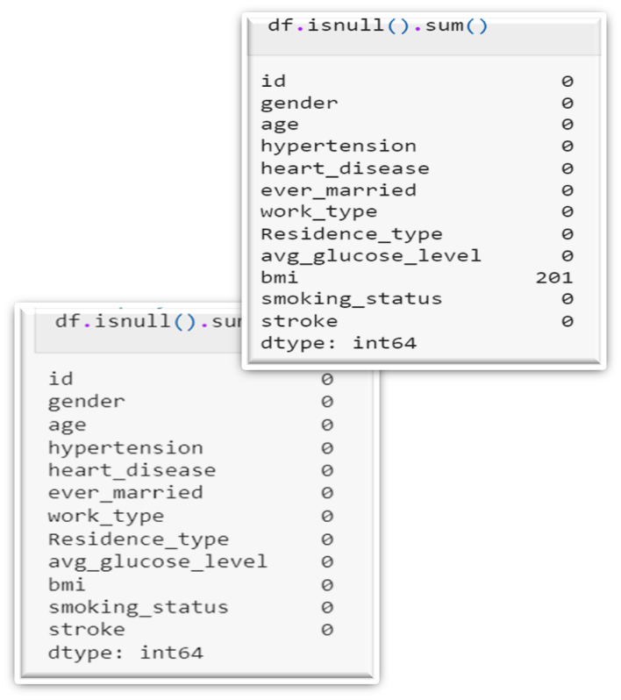
(Q) Is it good to have null values in dataset ?
No, null values can hinder data analysis and model performance. They represent missing or incomplete information, which can lead to inaccuracies, biases, or errors if not properly handled. Addressing null values ensures the dataset is clean and reliable for analysis or model training.
Handling Null Values

Slide 9

02
Data Visualization

Slide 10
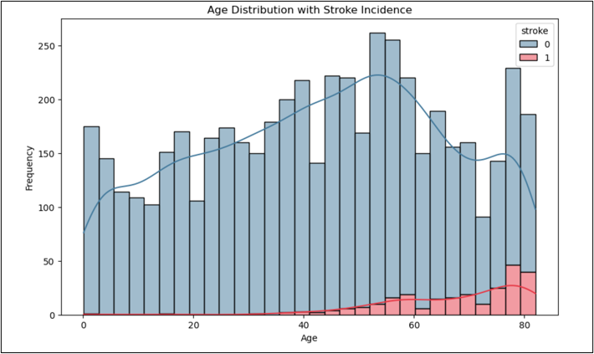
Age Distribution with Stroke Incidence
This part focuses on exploring the dataset visually to uncover meaningful patterns and relationships between variables. Through graphs and plots, we analyze trends and distributions, helping identify key insights related to stroke prediction. Additionally, data encoding ensures that categorical variables are transformed into a format suitable for machine learning models.
Visualization: A histogram with KDE overlay showing the distribution of age with stroke incidence.
Observation:
Stroke incidence increases significantly in older age groups.
Younger individuals have a relatively low frequency of strokes.

Slide 11
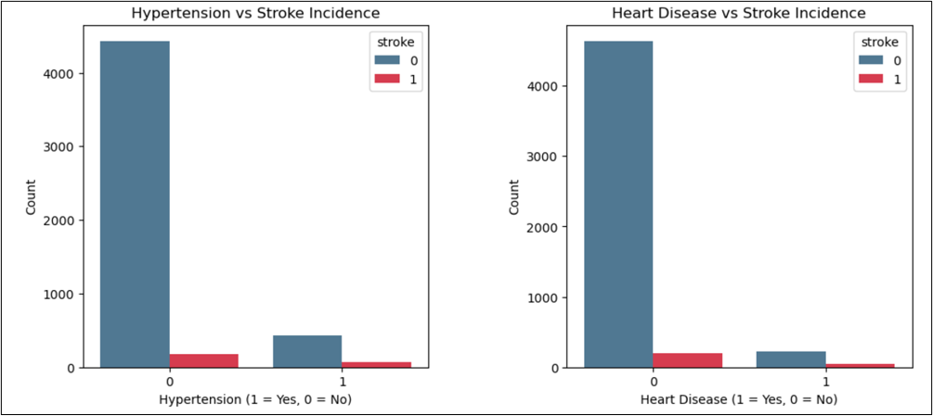
Hypertension and Heart Disease vs Stroke Incidence
Visualization: Two side-by-side bar plots depicting the correlation of hypertension and heart disease with stroke incidence.
Observation:
Hypertension and heart disease are strong predictors of stroke.
Individuals with either condition have a higher likelihood of experiencing a stroke.

Slide 12
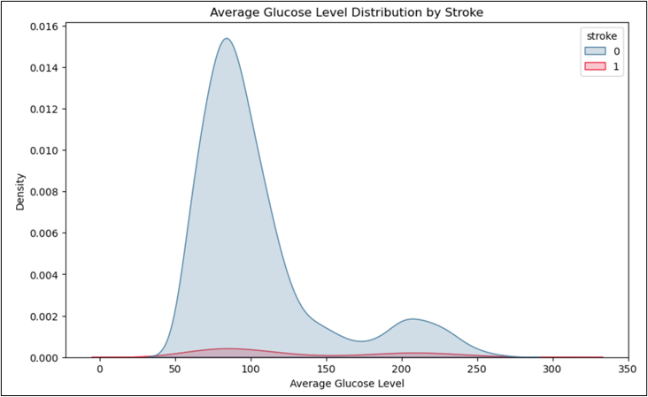
Average Glucose Level Distribution by Stroke
Visualization: A KDE plot illustrating the distribution of average glucose levels for stroke and non-stroke cases.
Observation:
Higher average glucose levels are associated with increased stroke incidence
A clear separation in glucose levels exists between stroke and non-stroke groups.

Slide 13
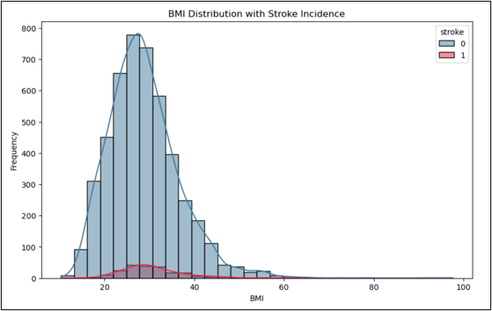
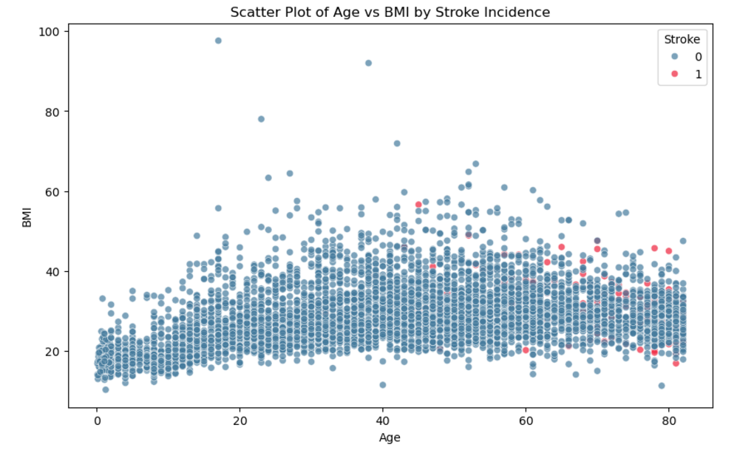
BMI Distribution with Stroke Incidence
Visualization: A histogram with KDE overlay depicting BMI distribution for stroke and non-stroke cases.
Observation:
Stroke cases are slightly more frequent among individuals with higher BMI.
BMI alone does not show a strong correlation with stroke.
Scatter Plot of Age vs BMI by Stroke Incidence
Visualization: A scatter plot showing the relationship between age, BMI, and stroke incidence.
Observation:
Most stroke cases cluster in older individuals with a range of BMI values.
No distinct pattern emerges in BMI but age is a significant factor.

Slide 14

03
Data Encoding

Slide 15


Data Encoding
Data encoding is the process of converting categorical data into numerical formats so that machine learning algorithms can interpret it.
Residence_type
Work_Type
Smoking_status
0-Rural
1-Urban
work_type_Never_worked
work_type_Private
work_type_Self-employed
smoking_status_never smoked
smoking_status_formerly smoked
smoking_status_smokes

